Slide 1
Business Intelligence

Slide 2
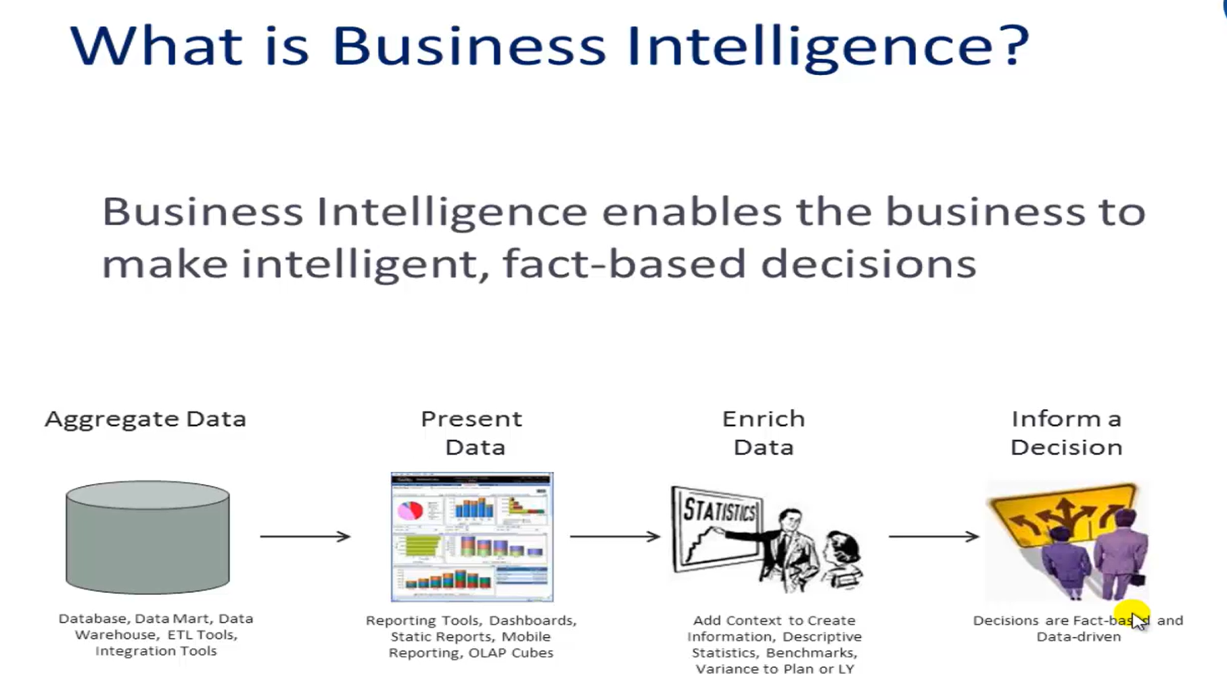

Slide 3
Introduction to Business Intelligence (BI)
Business Intelligence (BI) can be defined as the use of technologies, applications, and practices for the collection, integration, analysis, and presentation of business information.
BI involves gathering and processing data from various sources within and outside an organization to generate actionable insights that support informed decision-making.
The goal of BI is to help organizations gain a deeper understanding of their operations, identify trends and patterns, optimize processes, and achieve strategic objectives.

Slide 4
Importance of Business Intelligence
BI encompasses a wide range of activities including reporting, query and analysis, performance monitoring, and predictive analytics.
BI helps organizations gain a deeper understanding of their operations, identify trends and patterns, optimize processes, and ultimately achieve strategic objectives.

Slide 5
Gartner’s BI Maturity Model

Slide 6
Business Intelligence Maturity Model
The BI Maturity Model helps organizations assess their current level of BI maturity and identify areas for improvement.
At lower maturity levels, organizations may rely on spreadsheets and simple reporting tools for ad hoc analysis.
At higher maturity levels, sophisticated data-driven decision support systems are used.
The BI Maturity Model focuses on reporting, analysis, and key success indicators, suggesting strategies to leverage BI for business value.

Slide 7
Introduction to Gartner’s BI Maturity Model
Gartner’s BI maturity model is often regarded as superior to other maturity models due to its comprehensive framework.
It covers various aspects of business intelligence, including technology, processes, and people. T
he model considers organizational maturity across multiple dimensions, offering a holistic view of BI implementation.
Gartner ensures that its maturity model aligns with industry standards and best practices, enhancing its credibility and relevance to businesses worldwide.

Slide 8
The Five Levels of Maturity
Gartner’s BI Maturity Model identifies five levels of maturity:
1. Unaware Stage
2. Tactical Stage
3. Focused Stage
4. Strategic Stage
5. Pervasive Stage
These levels are assessed based on key areas such as people, processes, metrics, and technology.

Slide 9
Unaware Stage
During the unaware stage, organizations struggle with inaccurate and inconsistent data interpretation.
They rely heavily on spreadsheets with minimal use of reporting tools or dashboards.
Information management and reporting are primarily the responsibility of the IT department, with minimal investment in dedicated information management initiatives.

Slide 10
Tactical Stage
At the tactical level, organizations begin to invest in BI and reporting at the department level.
They use off-the-shelf software with few modifications, but users may not be fully skilled to maximize the system's potential.
There is low support and inadequate funding for initial BI projects, leading to concerns about system quality and consistency.

Slide 11
Focused Stage
In the focused stage, organizations achieve initial successes with BI, bringing certain benefits to the organization.
A specific business unit or senior management member is responsible for IT management, and management dashboards are created to optimize individual business units.
BI projects are funded by business units, but data remains unintegrated and available through individual stovepipe solutions.

Slide 12
Strategic Stage
At the strategic stage, organizations have a clear business strategy for achieving objectives through BI and reporting.
Top management sponsors BI initiatives, and critical business processes are driven by BI.
BI usage extends beyond the organization to include suppliers, customers, and business partners.
There is sufficient funding to ensure data quality and reliability for strategic decision-making.

Slide 13
Pervasive Stage
In the pervasive stage, BI and reporting are integral to business processes.
The BI framework is built to support business processes flexibly and proactively respond to dynamic information needs.
Information used for reporting and analysis is highly trustworthy, with a high level of data quality, and is effectively used at all levels of the company.
BI tools are also available for business partners, suppliers, and customers.

Slide 14
BI Dissemination
The dissemination of BI has evolved over time, from handwritten notes and manual surveys to sophisticated BI tools and techniques.
Historical progress in BI adoption reflects the growing importance of data-driven decision-making in optimizing business operations.
Today, BI is used across all aspects of business, from finance and marketing to performance analytics.

Slide 15
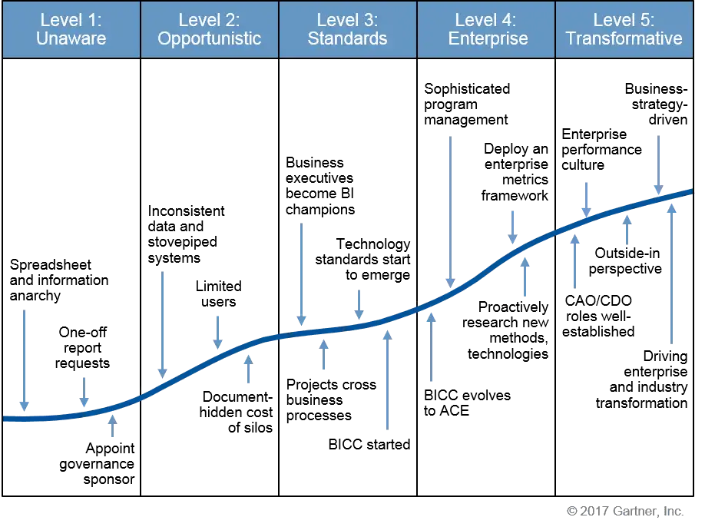

Slide 16
BI Dissemination
An Overview of BI Stages

Slide 17
Unaware Stage
At this level, BI and analytics are ad hoc, lacking formal decision-making processes or practices.
Requests for information from executives and managers prompt users to scramble for data from any available operational application.
The enterprise lacks an information infrastructure, with undefined processes for analytics, decision-making, or performance metrics.
This approach persists due to its low initial cost.

Slide 18
Opportunistic Stage
At this stage, business units undertake separate BI or analytics projects to enhance processes or assist in tactical decision-making.
Each project operates independently with its own infrastructure, tools, and metrics, leading to a proliferation of applications across the organization.
Output is delivered through reports, queries, and dashboards, supported by single-subject data marts and potentially data quality technology.

Slide 19
Standards Stage
At this stage of maturity, coordination among people, processes, and technologies within the enterprise begins to take shape.
A senior executive, often from the business side, assumes the role of championing BI and analytics initiatives.
Process managers and IT leaders oversee projects spanning various business processes, requiring shared analysis and decision-making.
Many enterprises establish BI competency centres (BICCs) or analytics centres of excellence to foster expertise sharing and ensure consistency.

Slide 20
Enterprise Stage
At this level, top executives become the program’s sponsors. The enterprise has defined a framework of performance metrics that links multiple processes to enterprise goals.
BI applications support cross-functional or enterprise-wide decision processes.
An enterprise information architecture guides the design of new systems, with significant funding for EIM and information sharing.

Slide 21
Transformative Stage
At this advanced stage, BI and analytics evolve into a strategic initiative, jointly managed by business and IT sectors.
The CEO or a Chief Analytics Officer may spearhead the program, viewing information as a strategic asset.
BI and analytics are leveraged to drive revenue, enhance operational efficiency, and deliver exceptional customer service.

Slide 22
BI Dissemination in Stages
In conclusion, BI dissemination is critical for organizations to gain insights, optimize processes, and remain competitive.
BI development fosters operational efficiency, strategic decision-making, and long-term success in today’s dynamic business environment.

Slide 23

Thank you!

